Slide 1


Cyber awareness
XYZ Corp
Notes:
1

Slide 2

WHY ME?
Coz Security is everyone’s Business!
ZERO DEGREES
2
Notes:
2

Slide 3

Setting the stage
Presenter Note: A Live demo to grasp user attention. A Metasploit webcam stream demo works great on end-users to show them seriousness of cyberthreats.
ZERO DEGREES
3

Slide 4

DON’T BE A PHISH
Be a Dolphin!
ZERO DEGREES
4
Notes:
4

Slide 5






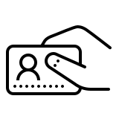
Deep dive : Phishing
Phishing accounts for over 90% of the initial access vector in Data Breaches.
Around 1.5m new phishing websites are created each month. – Webroot.
Phishing has grown over 65% over the last year.
30% of the phishing messages are opened by targeted users. – Verizon
76% organizations reported being a victim of a phishing attack. – Verizon.
Malware
Clicks a link
Exploit
User gets a Phishing email
Opens an attachment
Credential Theft
Phishing – Social Engineering technique, Mass email campaign to trick users into clicking a link or opening an attachment. Email’s will spoof legitimate services such as linkedin, Microsoft or amazon for authenticity.
Spear Phishing – Targeted campaign to individuals within an organization.
Vishing – Phishing, now available on Voice!
Digital Phishing – Phishing, now available everywhere – Whatsapp, Facebook, Instagram et all.
Whaling – Targets high-value employees such as CEO, CFO or other C-level executives.
ZERO DEGREES

Slide 6
Notable phishing tactics
Notification from a help desk or system administrator Asks you to take action to resolve an issue with your account (e.g., email account has reached its storage limit), which often includes clicking on a link and providing requested information.
Attachment labeled “invoice” or “shipping order” Contains malware that can infect your computer or mobile device if opened. May contain what is known as “ransomware,” a type of malware that will delete all files unless you pay a specified sum of money.
Notification from what appears to be a credit card company or Bank Indicates someone has made an unauthorized transaction on your account. If you click the link to log in to verify the transaction, your username and password are collected by the scammer.
Fake account on a social media site, email or service Mimics a legitimate person, business or organization. May also appear in the form of an online game, quiz or survey designed to collect information from your account.
Advertisement for immediate weight loss, hair growth or fitness prowess Serves as a ploy to get you to click on a link that will infect your computer or mobile device with malware or viruses.
ZERO DEGREES
6

Slide 7
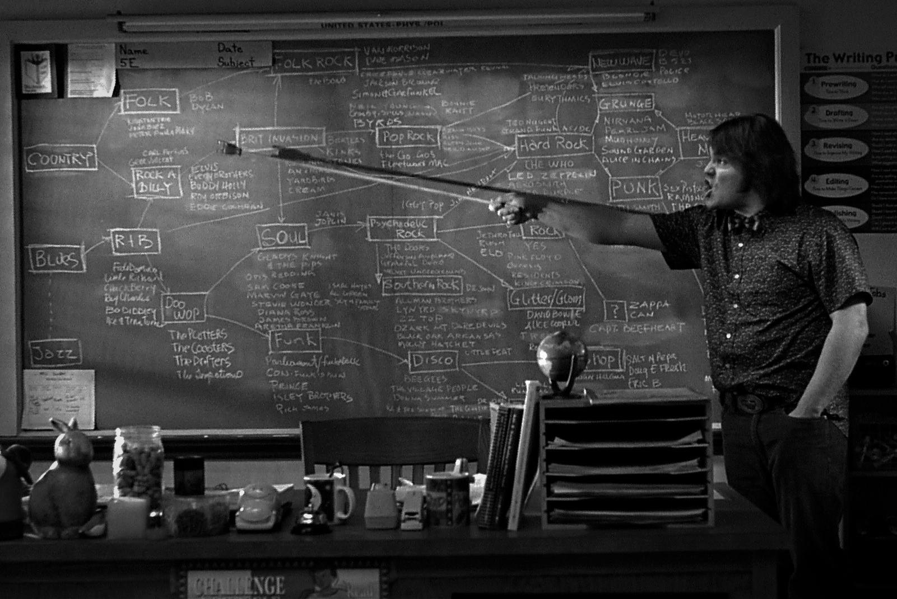
Dissecting phishing
The Fundamentals
ZERO DEGREES
7
Notes:
7

Slide 8
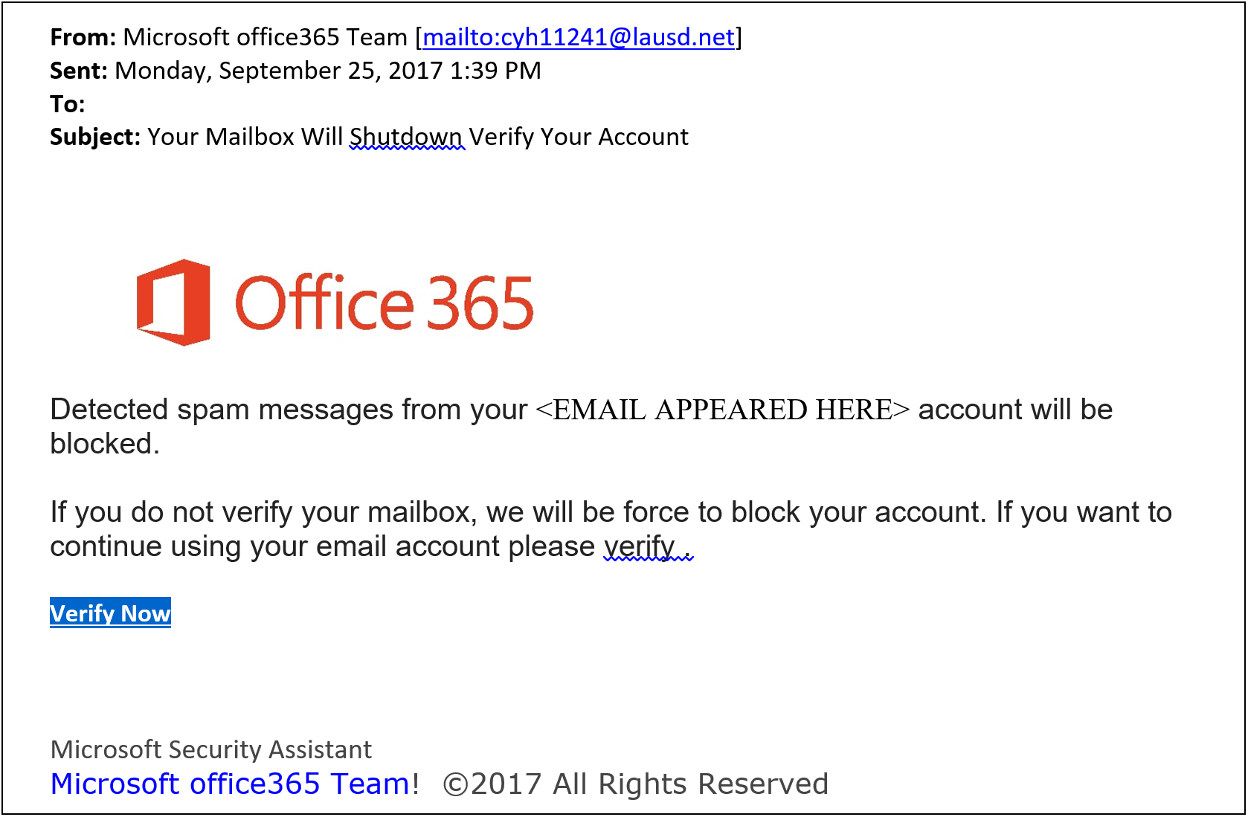
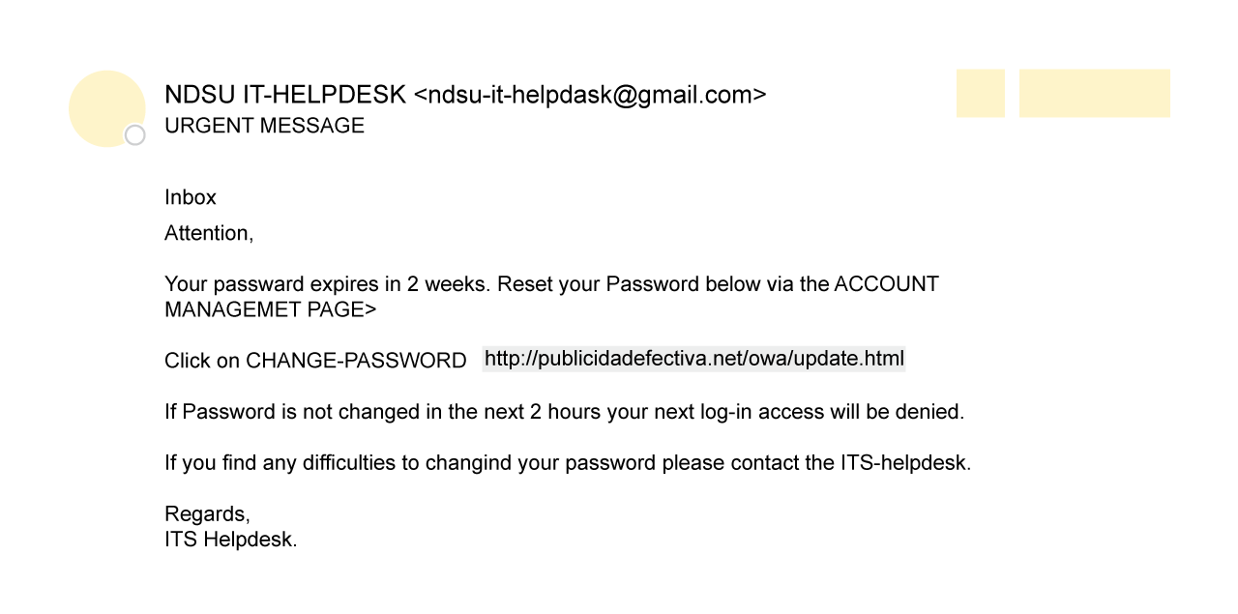
Anatomy of a phishing email
Is the email address correct for Microsoft?
Examine the spelling, grammar and punctuation.
Use the “hover” technique.
Does the displayed URL match the actual URL?
ZERO DEGREES
8

Slide 9
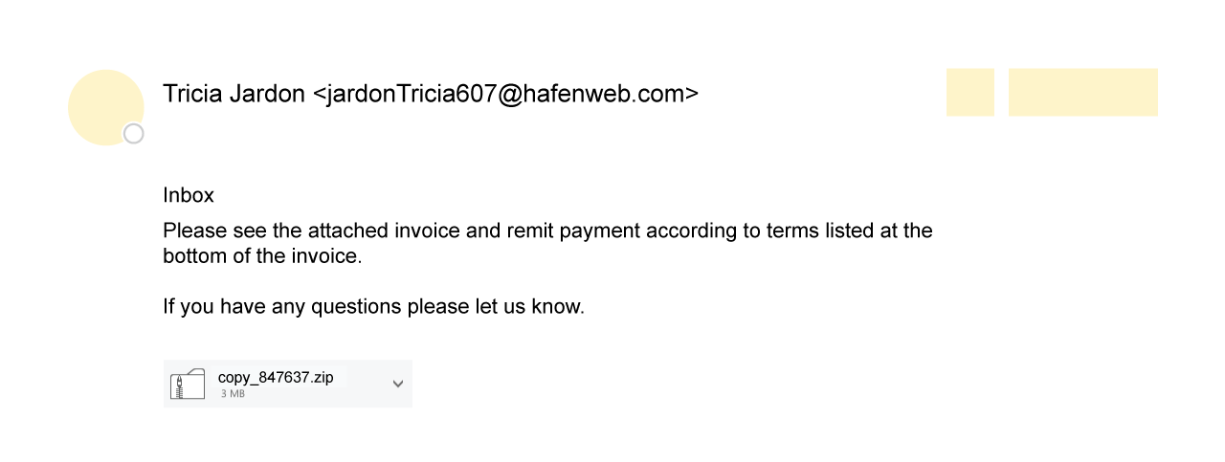
Anatomy of a phishing email
Do you know the sender?
There is no greeting
There is no salutation or signature
Are you expecting an attachment from this person or company?
ZERO DEGREES
9

Slide 10
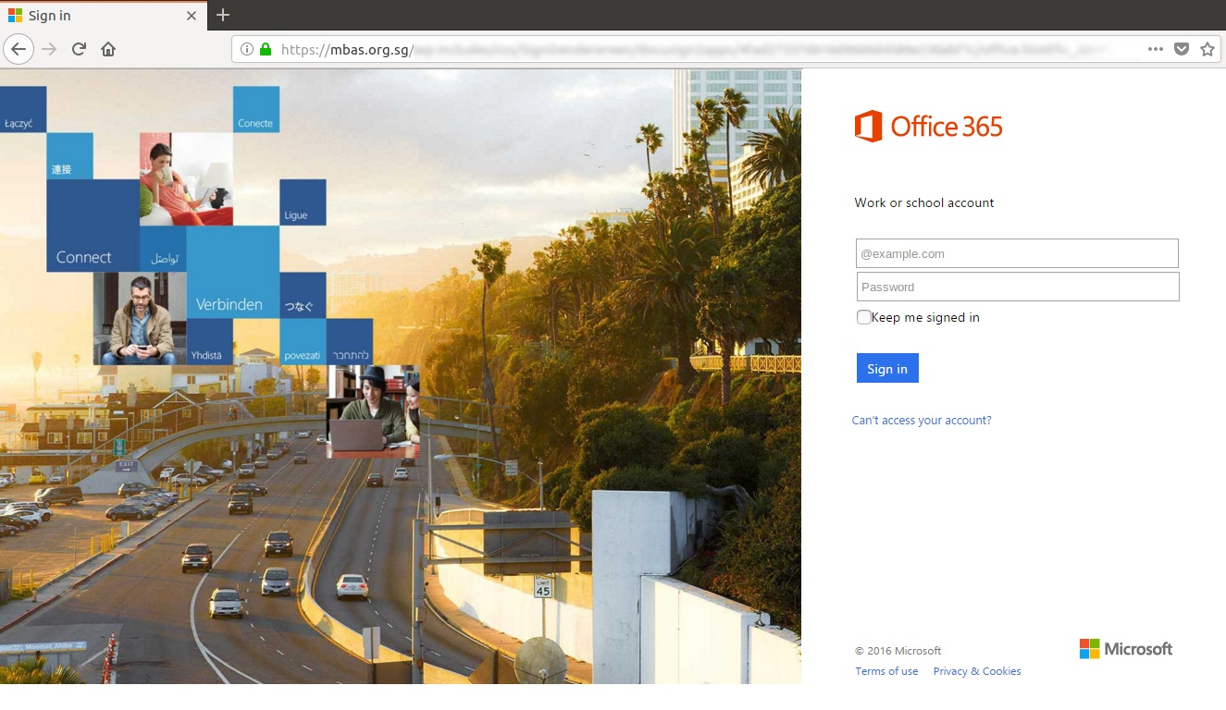
Anatomy of a phishing LINK
Examine the URL – is it a Microsoft.com URL?
Check for spelling errors
ZERO DEGREES
10

Slide 11
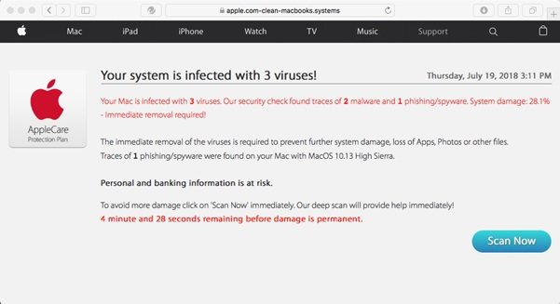
CHECK FOR ADVANCED TACTICS
There should be a / after apple.com
ZERO DEGREES
11

Slide 12
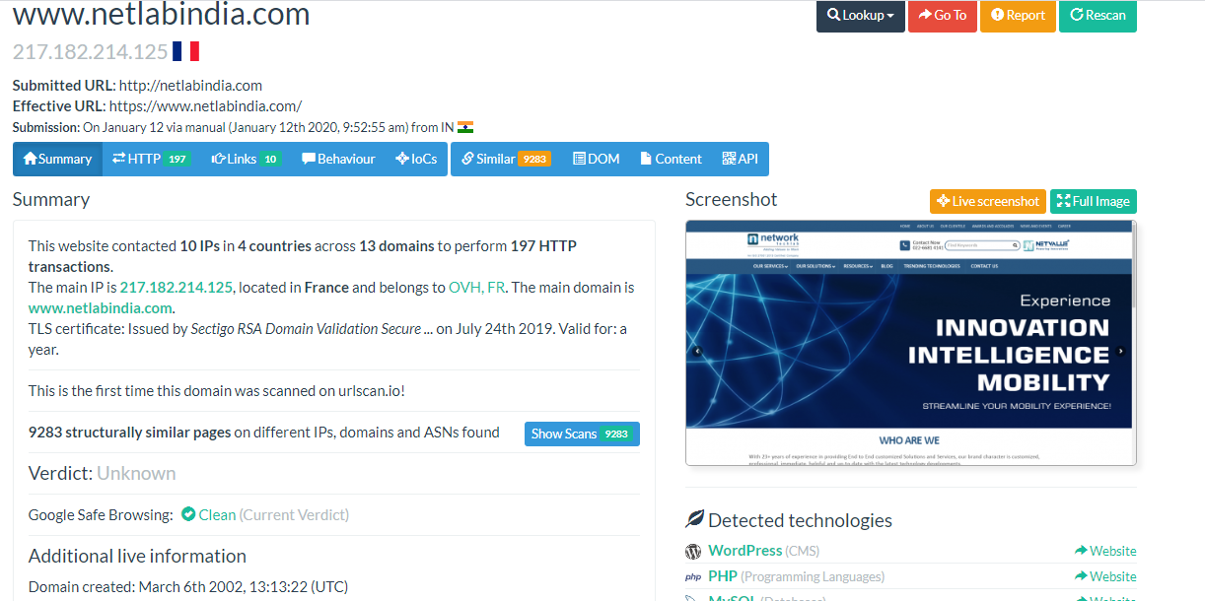
Still curious?
If you still feel curious, verify the link with urlscan.io and check out the screenshot
Remember to Notify IT at mailbox@mailbox.com for any suspicious links.
ZERO DEGREES
12

Slide 13
Password Security
ZERO DEGREES
13
Notes:
13

Slide 14
Passwords…..
DO NOT WRITE PASSWORDS DOWN & PASTE IT IN YOUR CUBICLE!
If you have difficulty remembering passwords, use a password manager.
Use 15 character, Alphanumeric, special characters, non-repeatable, random Passwords.
Yeah Right!
Use Phrases instead!
AnAppleADayKeepsTheDoctorAway
Improve it with numbers:
AnAppl3ADayK33psTheDoctorAway
Improve it with Special Characters:
@nAppl3ADayK33psTheDoctorAway!
ZERO DEGREES
14

Slide 15
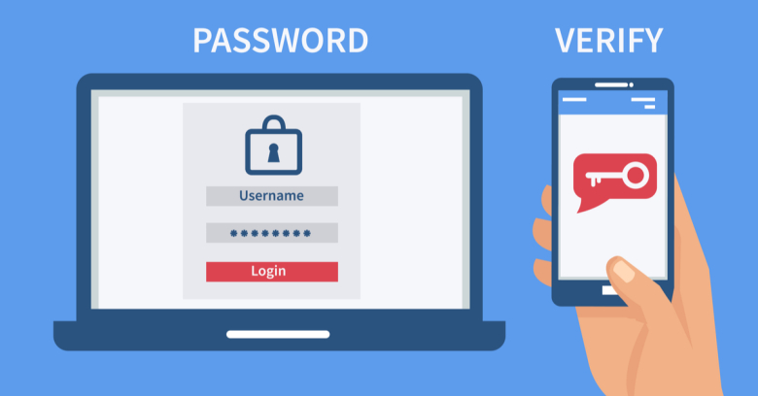





SECURE YOUR ACCOUNT
These apps already support TWO Factor Authentication via APP or SMS. Secure your account today!
TURN ON TWO FACTOR / TWO STEP AUTHENTICATION
SOMETHING YOU KNOW/ARE + SOMETHING YOU HAVE = YOU!
Can be Fingerprint, an App on your Phone or SMS!
USE THESE APPS
To manage your Authentication Codes
Google Authenticator
Microsoft Authenticator
ZERO DEGREES
15

Slide 16
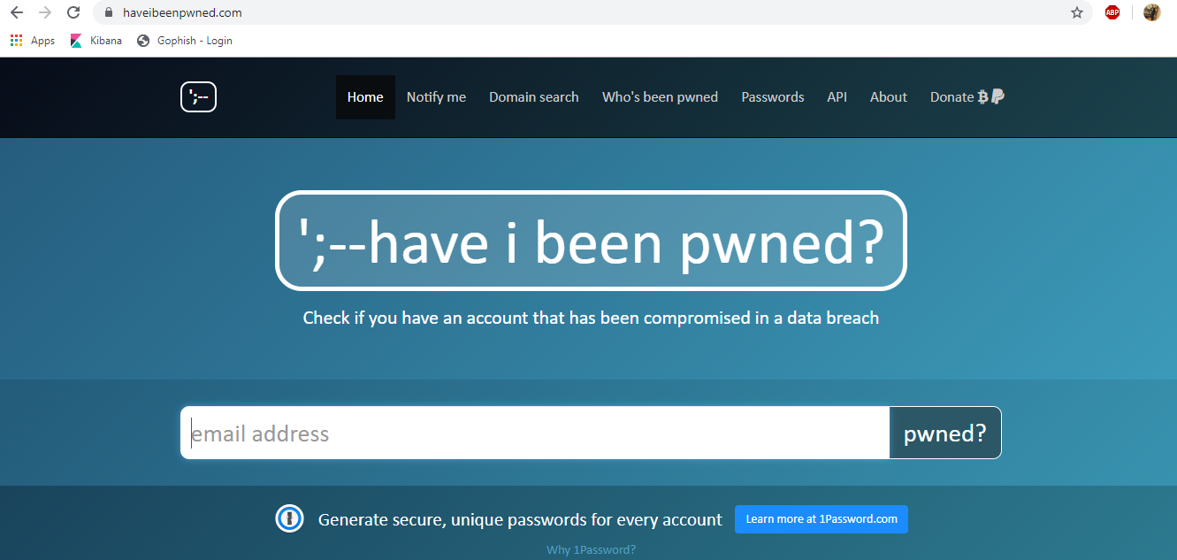
HAVE YOU ALREADY BEEN HACKED?
Data leaks and website compromises could mean that your account is already hacked!
Regularly change passwords on your apps.
Keep separate passwords for your financial accounts. Ideally keep ALL separate.
Use password managers if possible. (They could also be hacked ☹ )
haveibeenpwned.com
ZERO DEGREES
16

Slide 17
General security practices
Keep yourself and the organization secure
ZERO DEGREES
17
Notes:
17

Slide 18

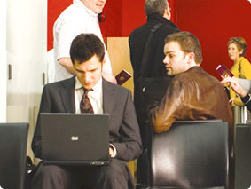
Beware of shoulder surfers
IT can only control so much…
Non-technological means such as shoulder surfing or social engineering can put YOU and YOUR ORGANIZATION at risk.
Be Aware of your surroundings.
Don’t work on sensitive data in public places.
DO: Use a screen shield to prevent shoulder surfing.
ZERO DEGREES
18

Slide 19
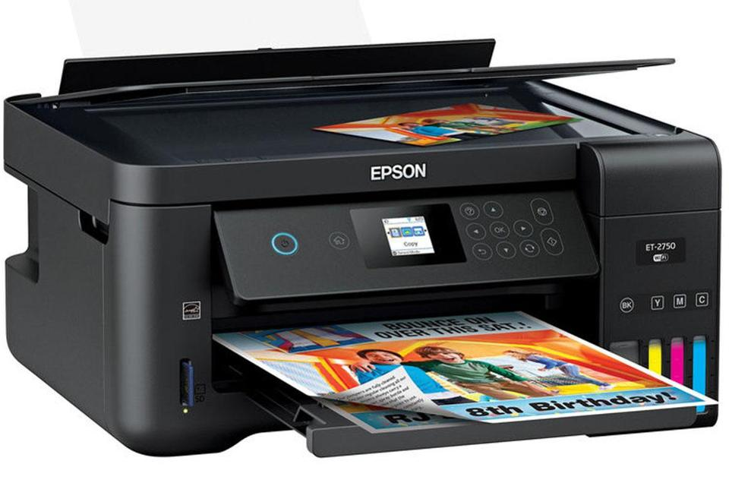
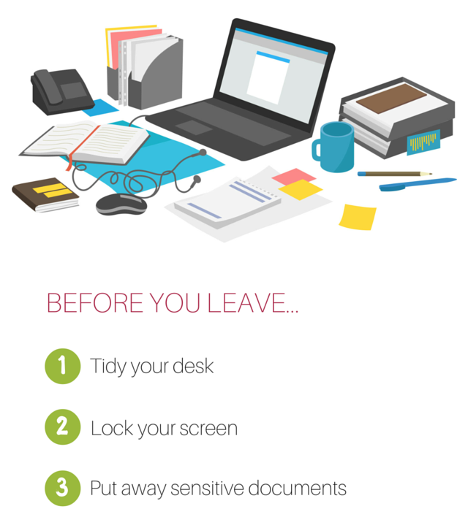

Clean desk & Environment
Don’t leave sensitive
Documents at the printer.
Clear Meeting room artifacts of sensitive discussion.
ZERO DEGREES
19

Slide 20
The Next Steps
ACTION!
ZERO DEGREES
20
Notes:
20

Slide 21


PROTECT YOURSELF
Click on Links in EMAIL.
Ignore phishing emails.
Blindly open attachments.
Enter your information on suspicious websites.
Write Passwords down.
Leave confidential information open for everyone.
Be aware of shoulder snoopers.
Always VERIFY.
Notify the IT Security team
Verify sender and mail. Is it really meant for you?
Always report suspicious Mails, Attachments or Websites to IT.
Use Password techniques to have complex but easy to remember passwords.
Lock your PC when not using it.
Remove any printouts or written notes from printers/cubicles/meeting rooms.
ZERO DEGREES
21

Slide 22
PROTECT YOURSELF: REPORT A PHISHING EMAIL
If you have received a suspicious / phishing message:
Forward it directly to <CUSTOMER-EMAIL> which keeps intact important information that may help IT staff identify the source of the scam.
Then delete the message.
ZERO DEGREES
22

Slide 23
Got HOOKED?: report immediately
If you suspect… | You should…
You interacted with or replied to a phishing scam using your OFFICIAL email account | Immediately contact the IT Help Desk: <email> or <number>
You might have revealed or shared personal or financial information | Immediately change the password(s) for your account(s). If you use the same password for multiple accounts and sites, change it for each account. Do not reuse that password in the future. Watch for signs of identity theft by reviewing your bank and credit card statements for unauthorized charges and activity. If you notice anything unusual, immediately contact your credit card or bank.
ZERO DEGREES
23

Slide 24
ZERO DEGREES
WOODGROVE BANK
THANK YOU
Ashish Chalke
Notes:
24

